Slide 1
oTree: day 2
Filipp Chapkovski
April 4, 2017

Slide 2
What we gonna do today
oTree, mTurk and BigFive Survey
Standard public good game
Public good game with punishment
Django Channels
Your projects

Slide 3
oTree and mTurk
general info: what is Amazon mTurk?
Requesters post HITs, Workers do them.
60% female and 83.5% white participants
a mean age of 32.2 and 14.9 years of education.
“even the highest pay rate we have used on MTurk of $.50 for a 5-min survey (an effective hourly rate of $6) …By contrast, per subject costs for typical undergraduate samples are about $5 to $10, for non-student campus samples about $30.”
Berinsky, Adam J., Gregory A. Huber, and Gabriel S. Lenz. "Evaluating online labor markets for experimental research: Amazon. com's Mechanical Turk." Political Analysis 20.3 (2012): 351-368.
Notes:
The MTurk population convenience sample (surveying a population based on available respondents) had 60% female and 83.5% white participants, with a mean age of 32.2 and 14.9 years of education. Earlier student samples had a mean age of 20.3 years, while adult samples had 75.5% female participants with 5.48 years of education. “The MTurk respondent pool has attractive characteristics — even apart from issues of cost.”
The MTurk sample was only slightly more female (60% versus 58%) and less educated (14.9 years of schooling versus 16.2) than the 2008 American National Election Panel Study. Its study participants were also more interested in politics in general, more likely to identify as Democrats and “substantially more liberal in their ideology.”
MTurk recruits “fare worse in comparison to [traditional national surveys] on demographic characteristics related to life cycle events.” Recruits are more likely to live in the northeastern United States, have never married (51%), rent versus own their home (53%) and not be affiliated with a major religion (42%).
With respect to the costs associated with study participant identification and recruitment, “even the highest pay rate we have used on MTurk of $.50 for a 5-min survey (an effective hourly rate of $6) is still associated with a per-respondent cost of $.55 (including Amazon.com’s 10% surcharge) or $.11 per survey minute. By contrast, per subject costs for typical undergraduate samples are about $5 to $10, for non-student campus samples about $30 … and for temporary agency subjects between $15 and $20.”

Slide 4
mTurk: who are they?
“ An informal look at some of the data shows that males are particularly more likely to take HITs during working hours from 9 am to 5 pm. These data may suggest that during working hours Workers are likely to be unemployed males.”
Panos Ipeirotis (March 16, 2009). "Turker Demographics vs Internet Demographics". New York University.

Slide 5
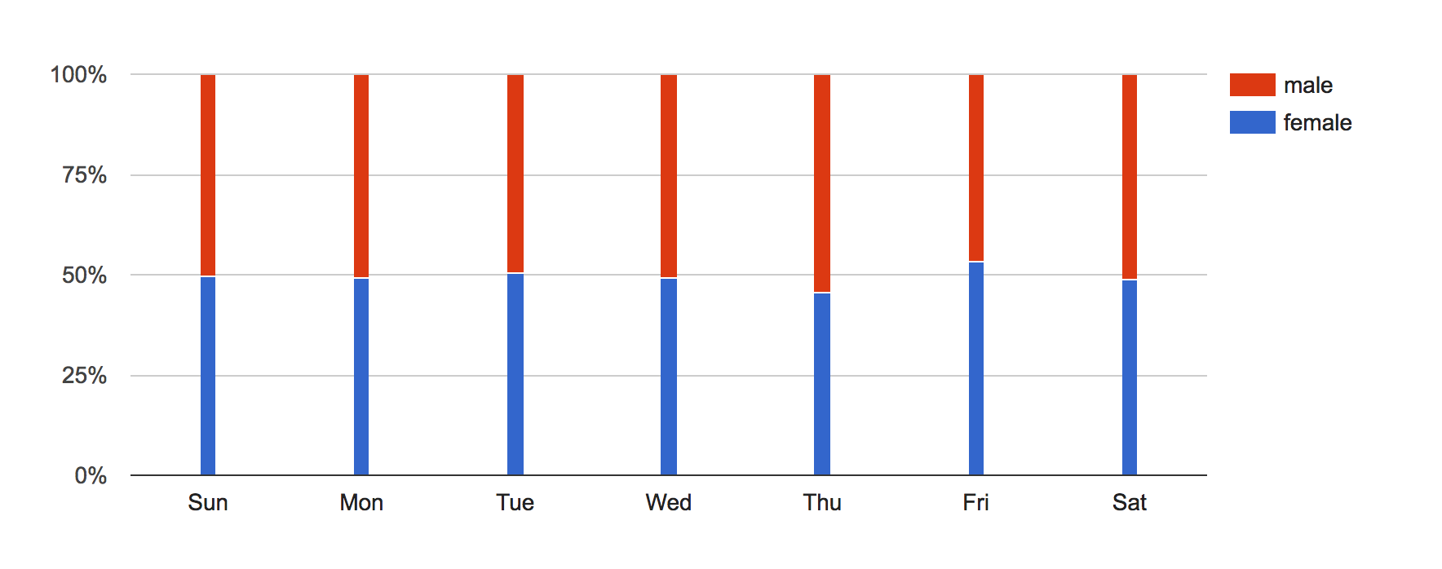
mTurk – gender
source: http://demographics.mturk-tracker.com/#/gender/all
Ipeirotis, Panagiotis G. "Analyzing the amazon mechanical turk marketplace." XRDS: Crossroads, The ACM Magazine for Students 17.2 (2010): 16-21.

Slide 6
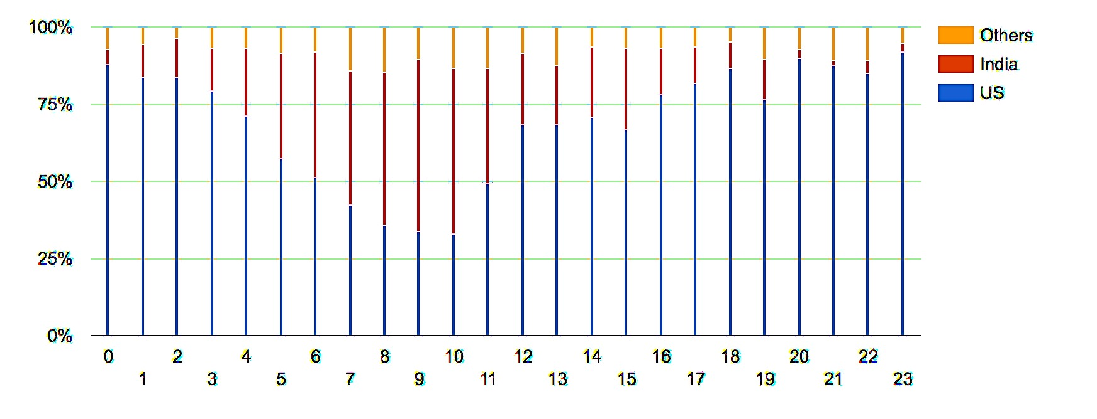
mTurk – per hour distribution across countries
source: http://demographics.mturk-tracker.com/#/gender/all
Ipeirotis, Panagiotis G. "Analyzing the amazon mechanical turk marketplace." XRDS: Crossroads, The ACM Magazine for Students 17.2 (2010): 16-21.

Slide 7
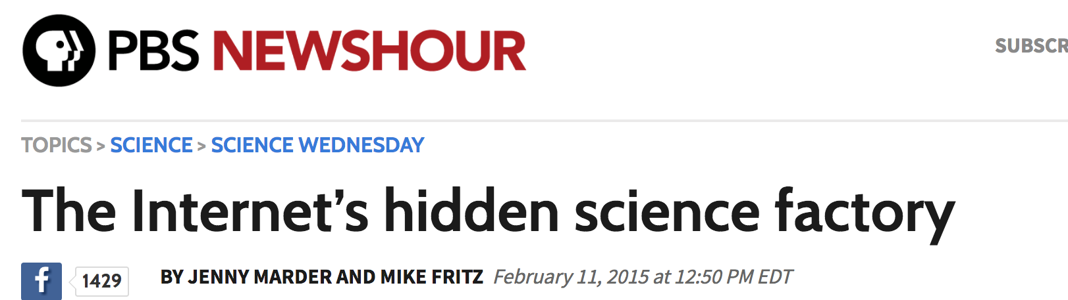
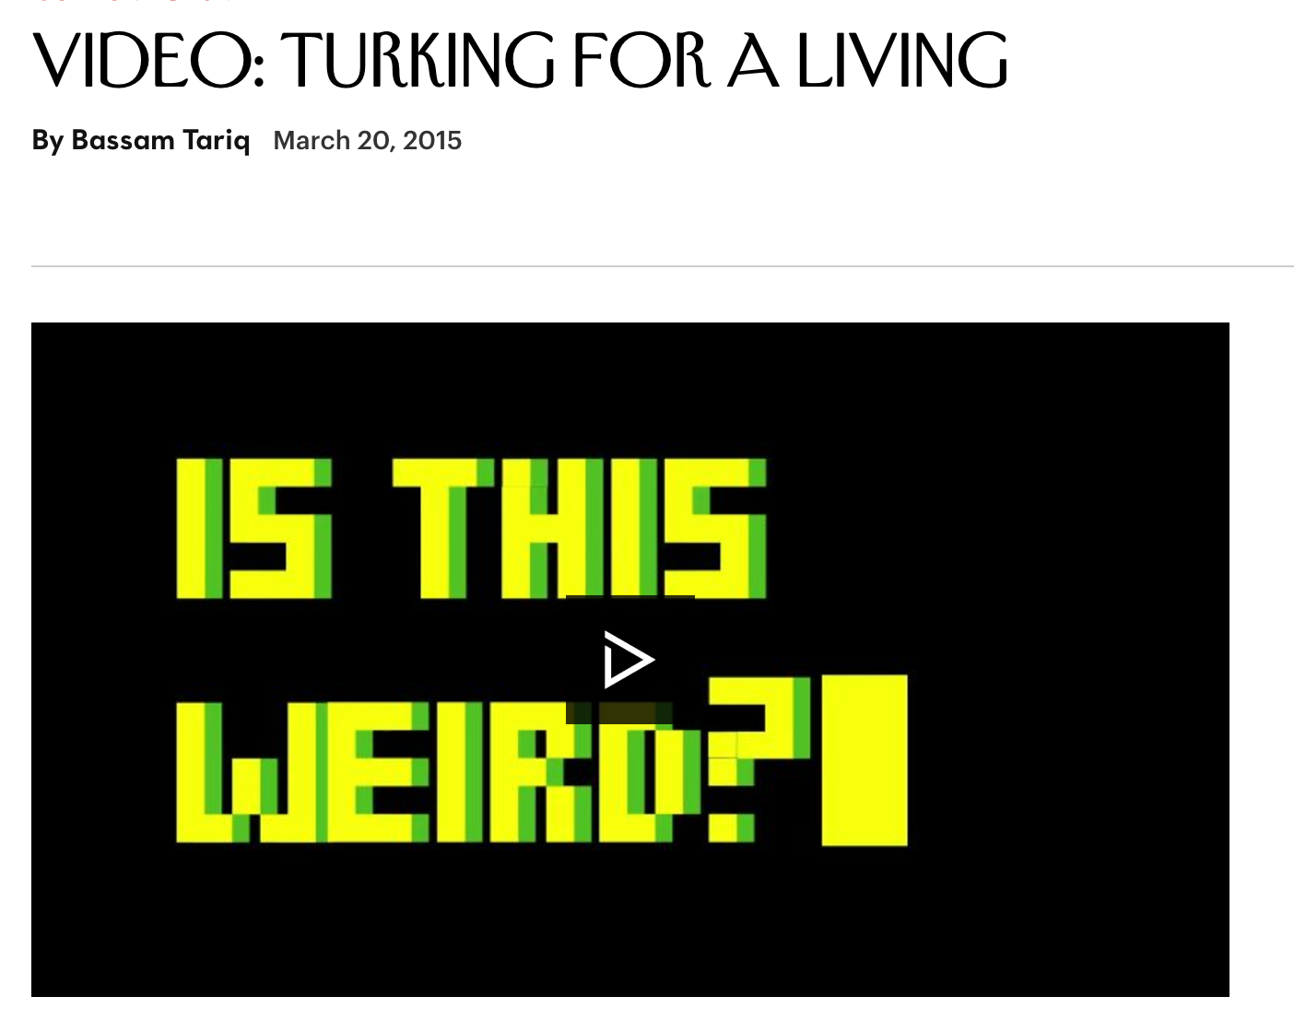
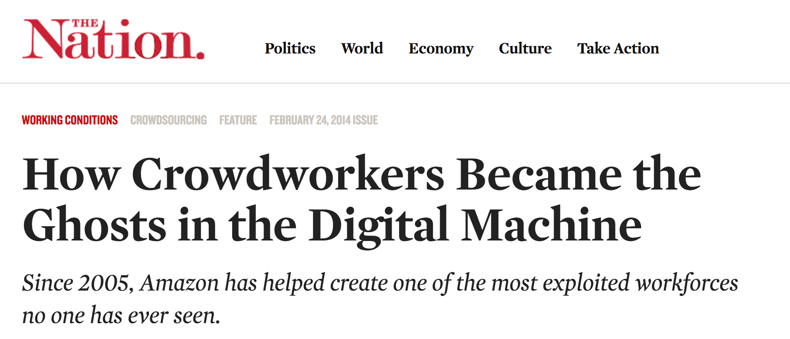
Notes:
https://www.thenation.com/article/how-crowdworkers-became-ghosts-digital-machine/
http://www.newyorker.com/culture/culture-desk/video-turking-for-respect
http://www.pbs.org/newshour/updates/inside-amazons-hidden-science-factory/

Slide 8
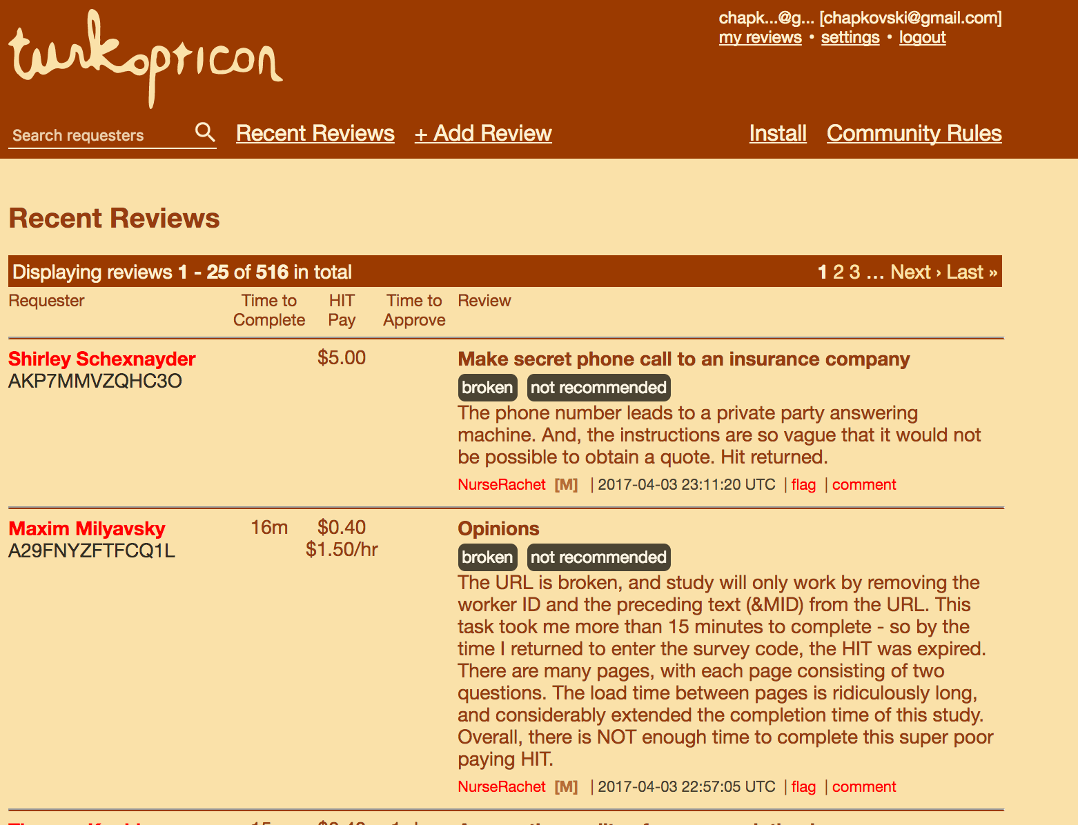
Requester’s Reputation

Slide 9
Issues: too sensitive, too experienced
Krupnikov, Yanna, and Adam Seth Levine. "Cross-sample comparisons and external validity." Journal of Experimental Political Science 1.1 (2014): 59.
Chandler, Jesse, Pam Mueller, and Gabriele Paolacci. "Nonnaïveté among Amazon Mechanical Turk workers: Consequences and solutions for behavioral researchers." Behavior research methods 46.1 (2014): 112-130.

Slide 10
mturk and otree
settings.py:
AWS_ACCESS_KEY_ID = environ.get('AWS_ACCESS_KEY_ID')
AWS_SECRET_ACCESS_KEY = environ.get('AWS_SECRET_ACCESS_KEY')

Slide 11
mturk and otree
mturk_hit_settings = {
'keywords': ['easy', 'bonus', 'choice', 'study'],
'title': 'Title for your experiment',
'description': 'Description for your experiment',
'frame_height': 500,
'preview_template': 'global/MTurkPreview.html',
'minutes_allotted_per_assignment': 60,
'expiration_hours': 7*24, # 7 days
}

Slide 12
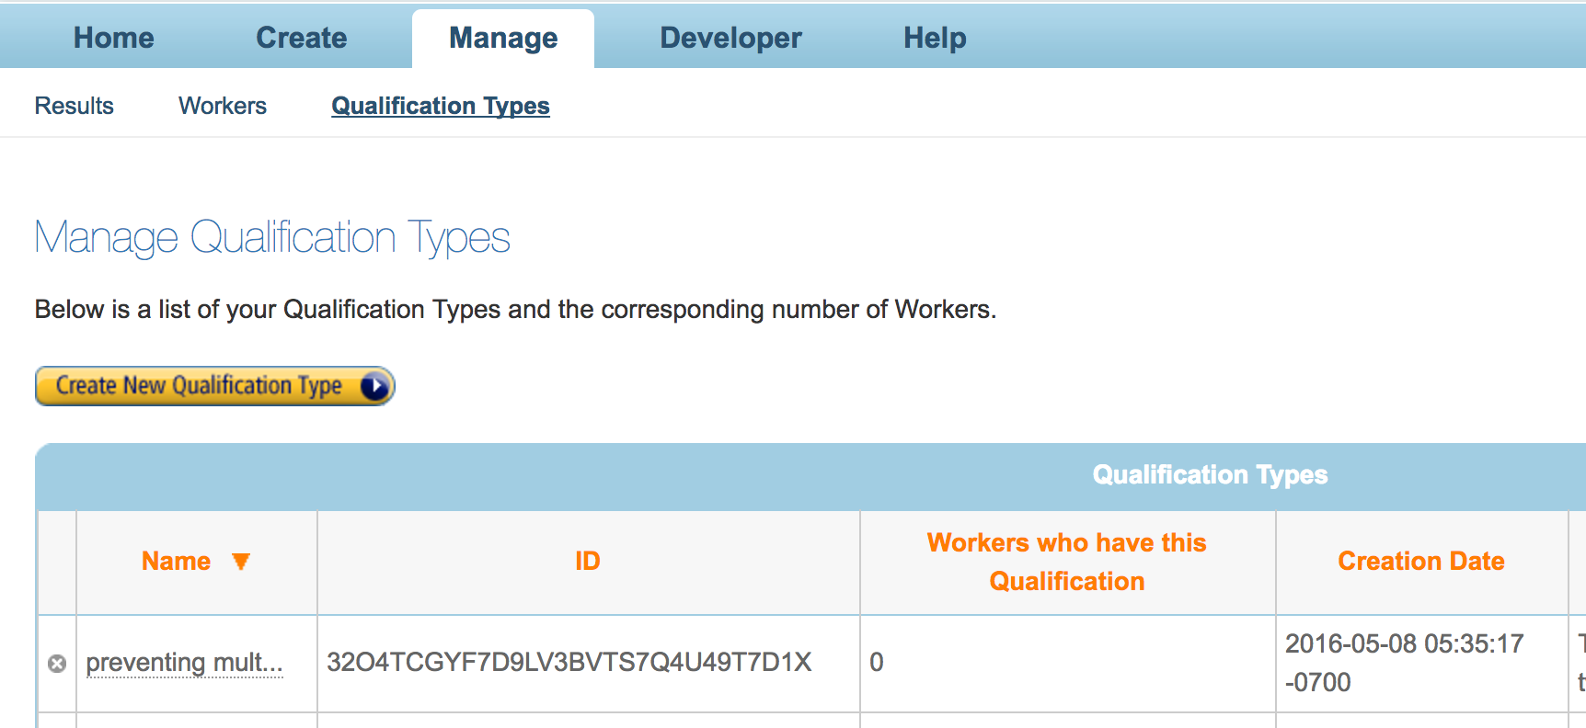
mTurk and oTree

Slide 13
Blocking the retakes
'grant_qualification_id': 'YOUR_QUALIFICATION_ID_HERE’ 'qualification_requirements': [
# qualification.LocaleRequirement("EqualTo", "US"),
# qualification.PercentAssignmentsApprovedRequirement("GreaterThanOrEqualTo", 50),
# qualification.NumberHitsApprovedRequirement("GreaterThanOrEqualTo", 5),
# qualification.Requirement('YOUR_QUALIFICATION_ID_HERE', 'DoesNotExist')
]

Slide 14
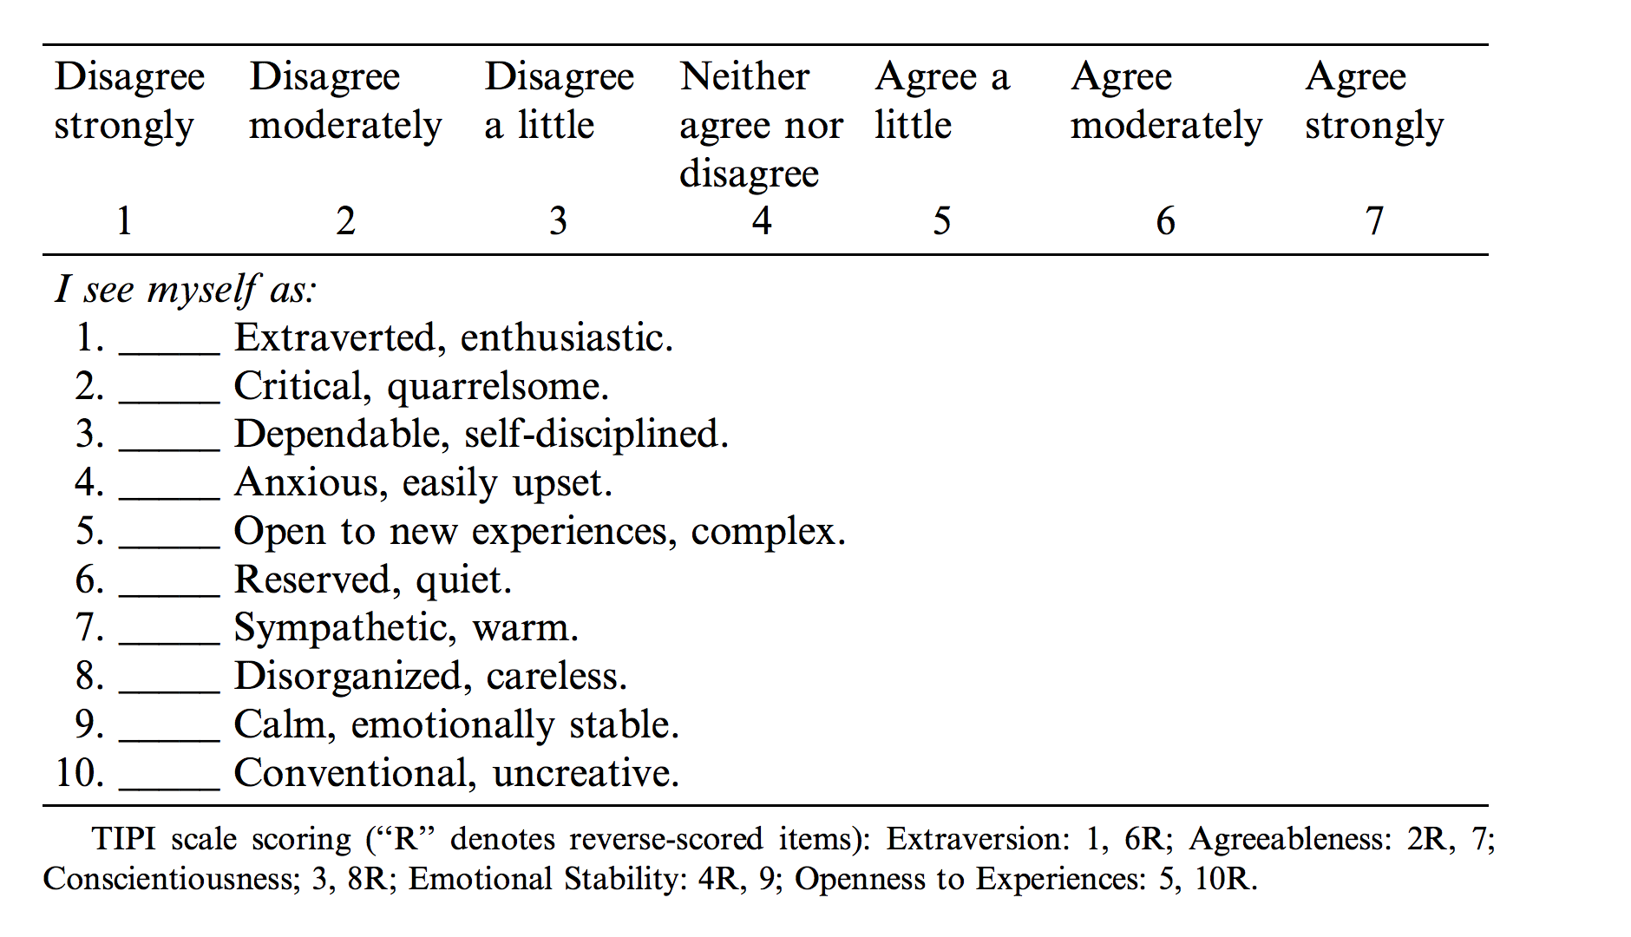
Big Five
Gosling, Samuel D., Peter J. Rentfrow, and William B. Swann. "A very brief measure of the Big-Five personality domains." Journal of Research in personality 37.6 (2003): 504-528.

Slide 15
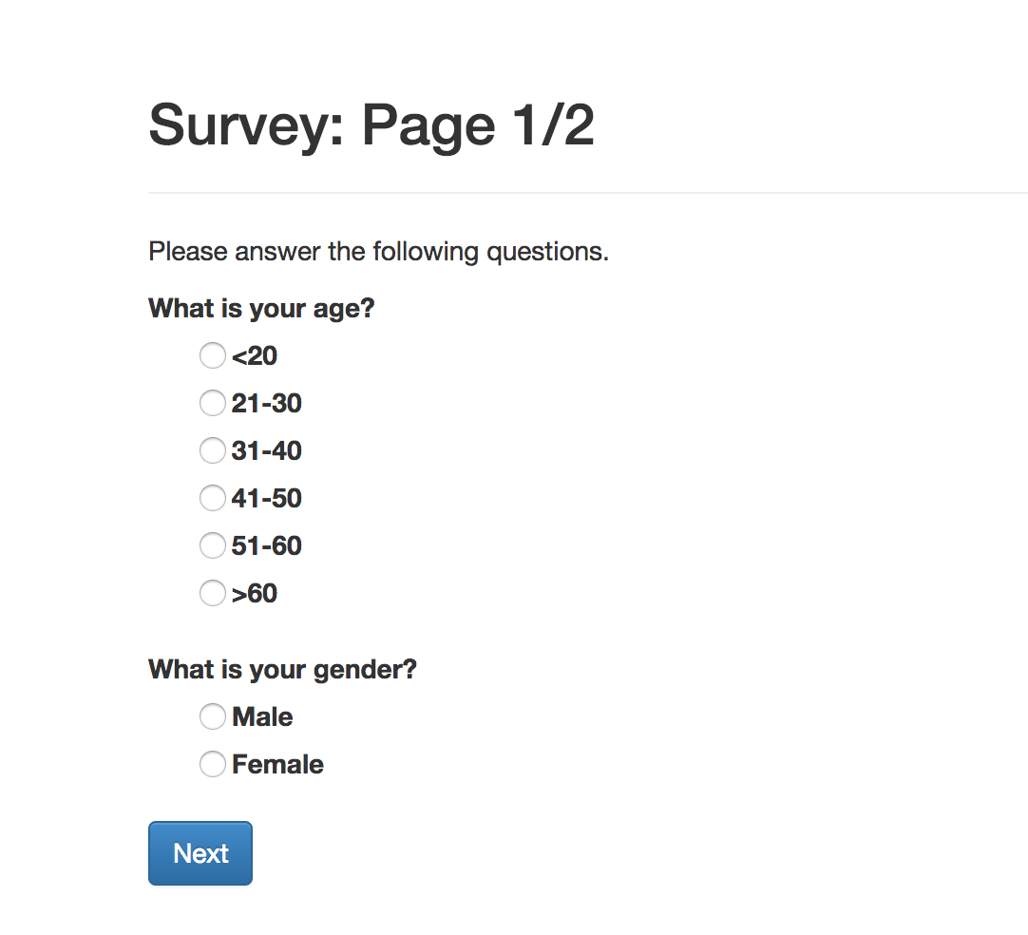

Slide 16
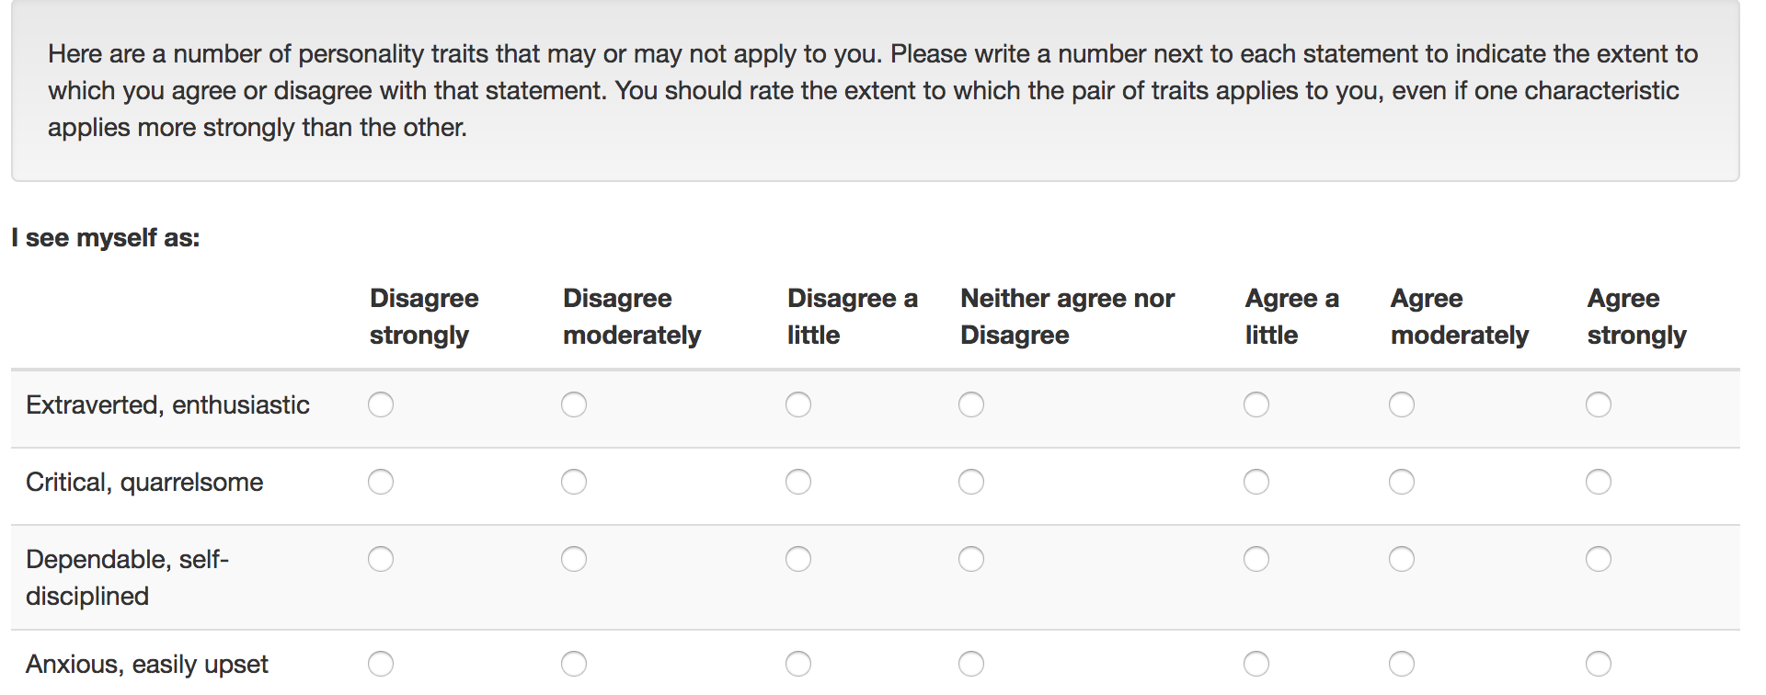

Slide 17
How to do it?
pip install django-radiogrid
in settings.py:
INSTALLED_APPS = ['otree', 'radiogrid',]
in models.py:
from radiogrid import RadioGridField
bigfive = RadioGridField(rows=ROWS, values=VALUES, require_all_fields=True,
verbose_name='I see myself as',)

Slide 18
How to do it?
ROWS = (
(1, "Extraverted, enthusiastic"),
(2, "Critical, quarrelsome"),
(3, "Dependable, self-disciplined"),
…
)
VALUES = (
(1, "Disagree strongly"),
(2, "Disagree moderately"),
(3, "Disagree a little"),
…
)

Slide 19
How to do it more beautiful?
with open('bigfive/big5q.csv') as f:
questions = f.readlines()
questions = [(i, x.strip()) for i, x in enumerate(questions)]
with open('bigfive/big5a.csv') as f:
answers = f.readlines()
answers = [(i, x.strip()) for i, x in enumerate(answers)]

Slide 20
How to do it more beautiful?
animals = ['cow', 'dog', 'cat']
for i,a in enumerate(animals):
print('Animal {} is {}'.format(i+1,a))
numericals = ['First', 'Second', 'Third']
for i,a in enumerate(animals):
print('My {} Animal is {}'.\
format(numericals[i],a))
print('============')
numanimals = zip(numericals,animals)
for i in numanimals:
print('My {} Animal is {}'.\
format(i[0],i[1]))

Slide 21
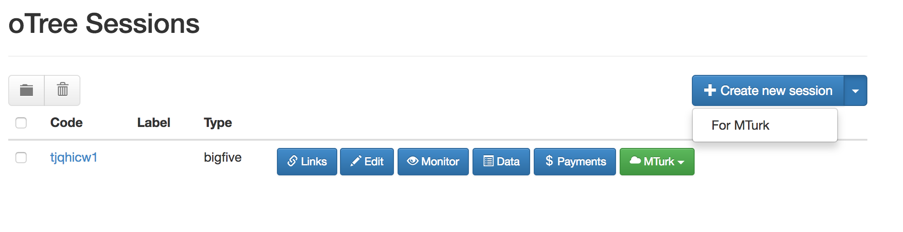
Running session in mTurk

Slide 22
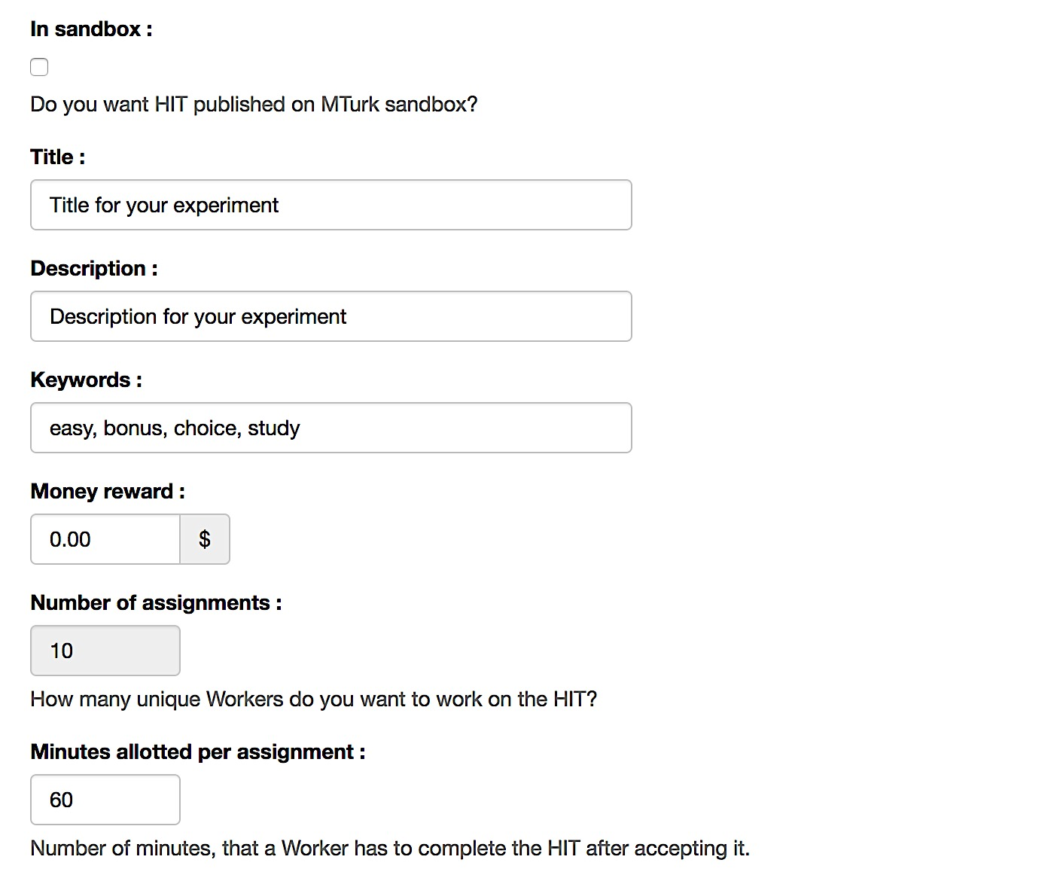
Running session in mTurk

Slide 23
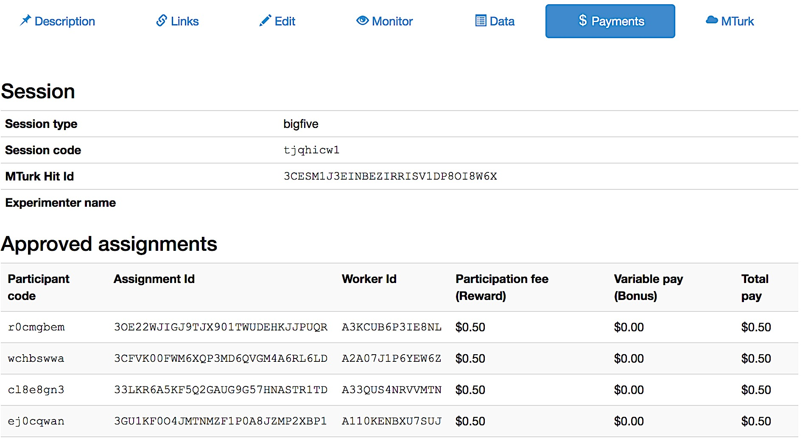

Slide 24
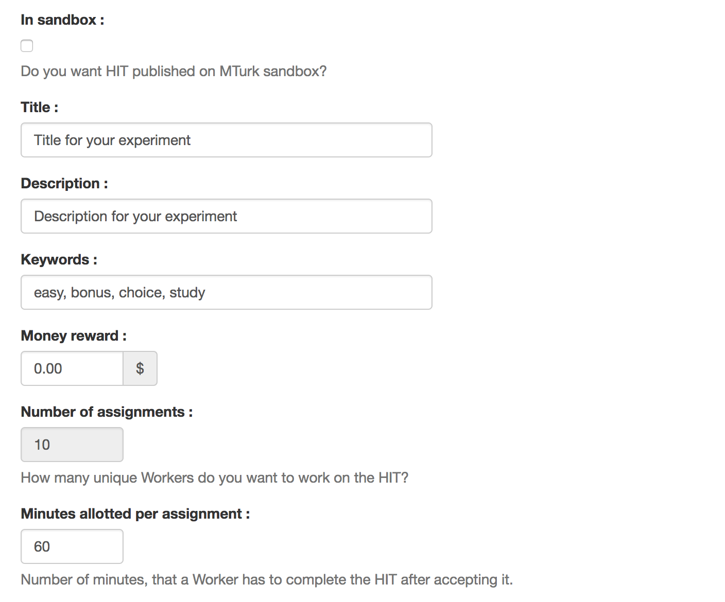
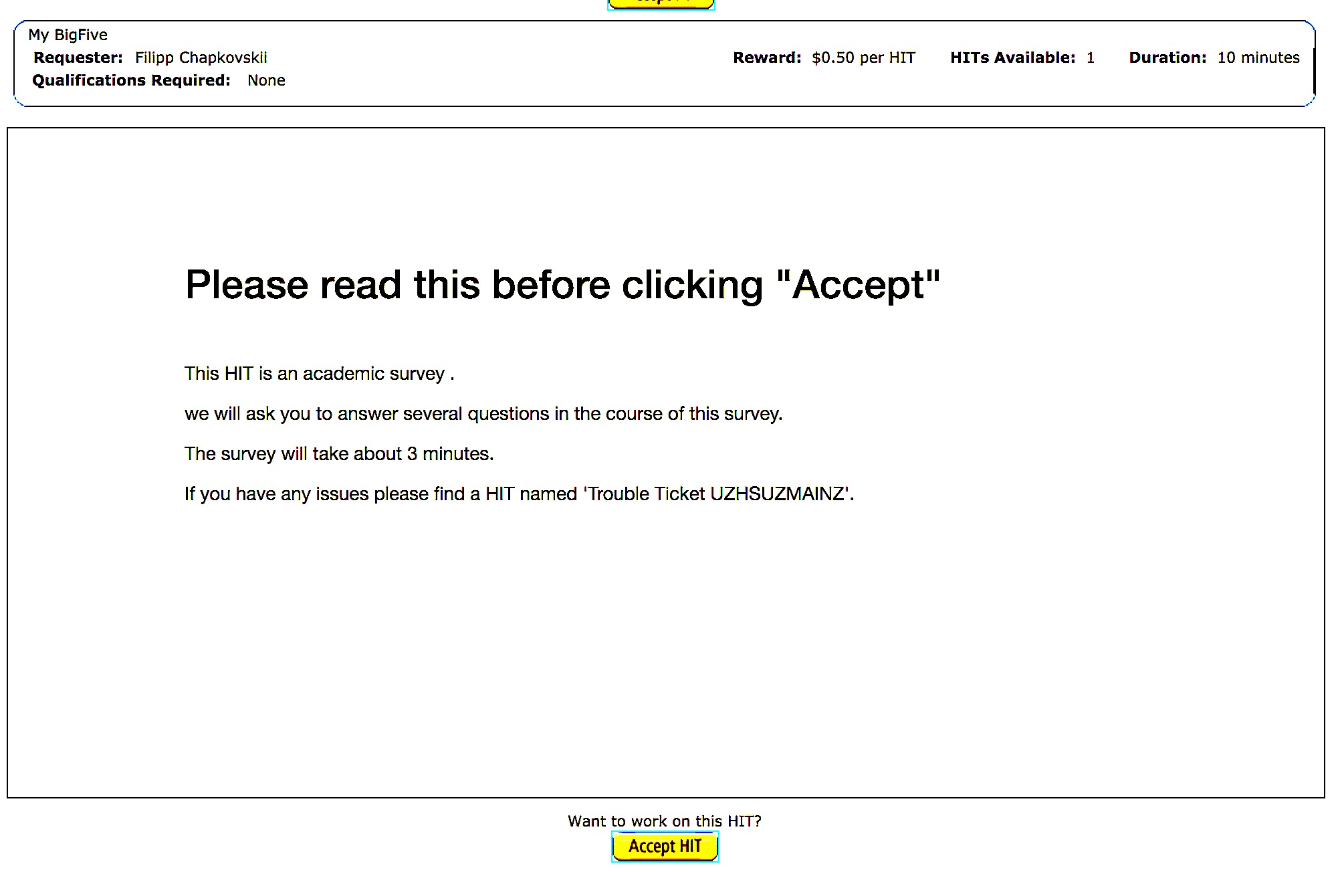

Slide 25
Multi-round PGG
Standard PGG.
Players play for 10 rounds
2 treatments: random and partner matching
We show gender of players
We show their earnings in previous rounds

Slide 26
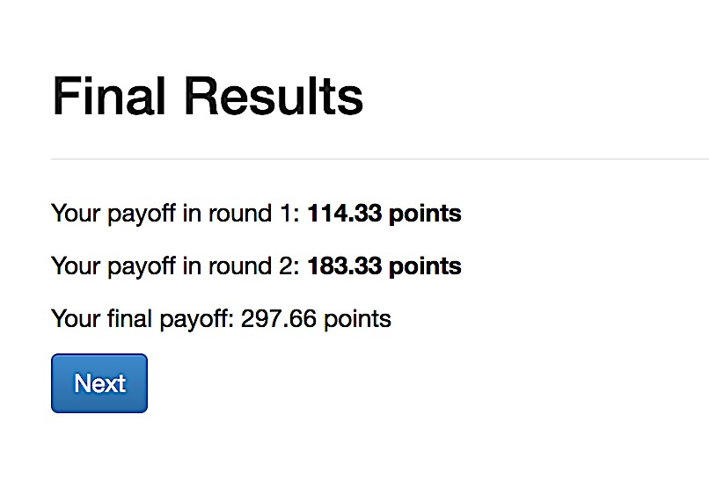
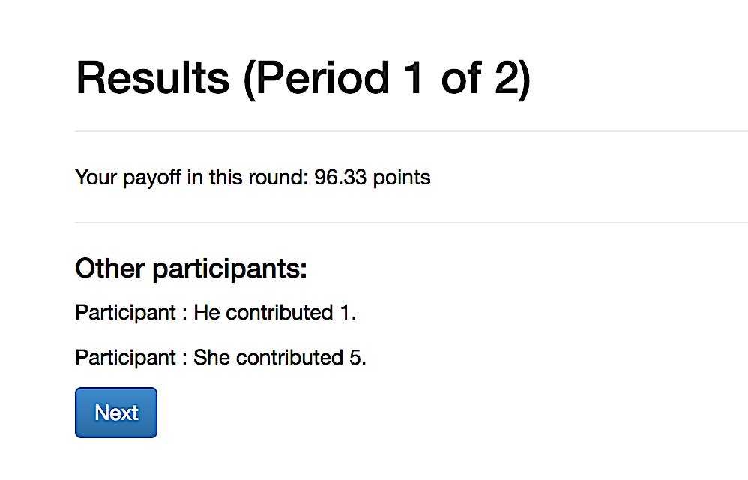
Multi-round PGG

Slide 27
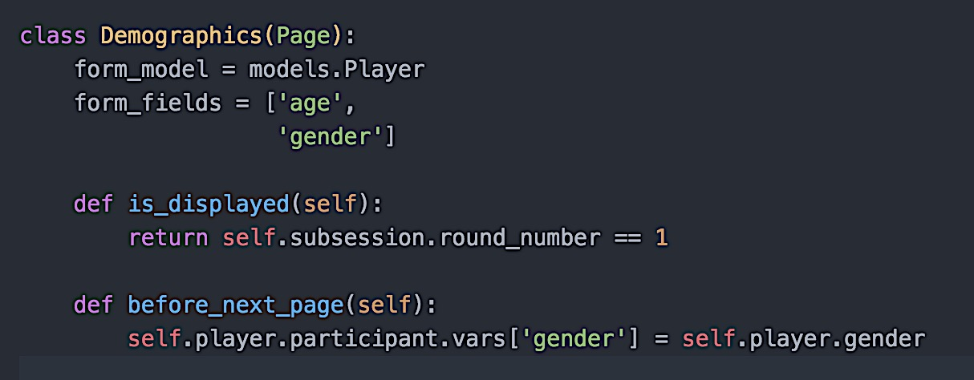
Multi-round PGG – how to do it
Gender – across rounds:

Slide 28
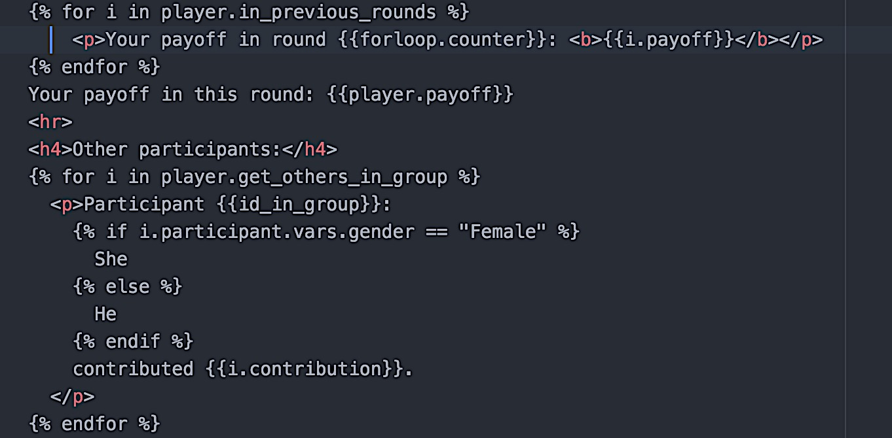
Showing results of previous rounds

Slide 29
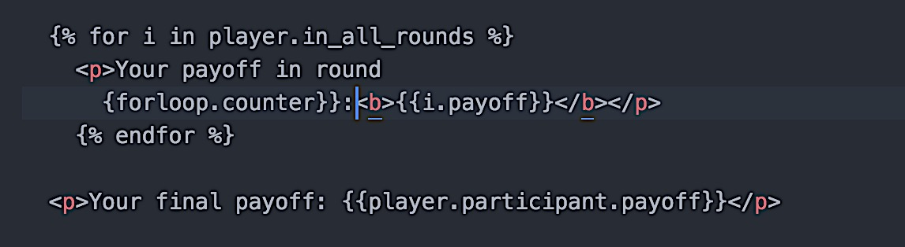
Multi-round PGG – how to do it
Showing results of all rounds in the last page

Slide 30
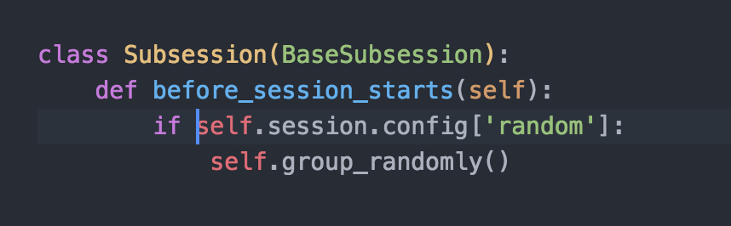
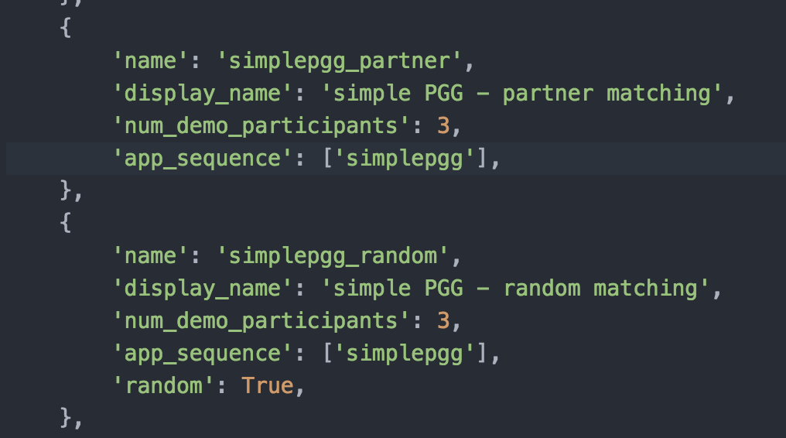
Shuffling players

Slide 31
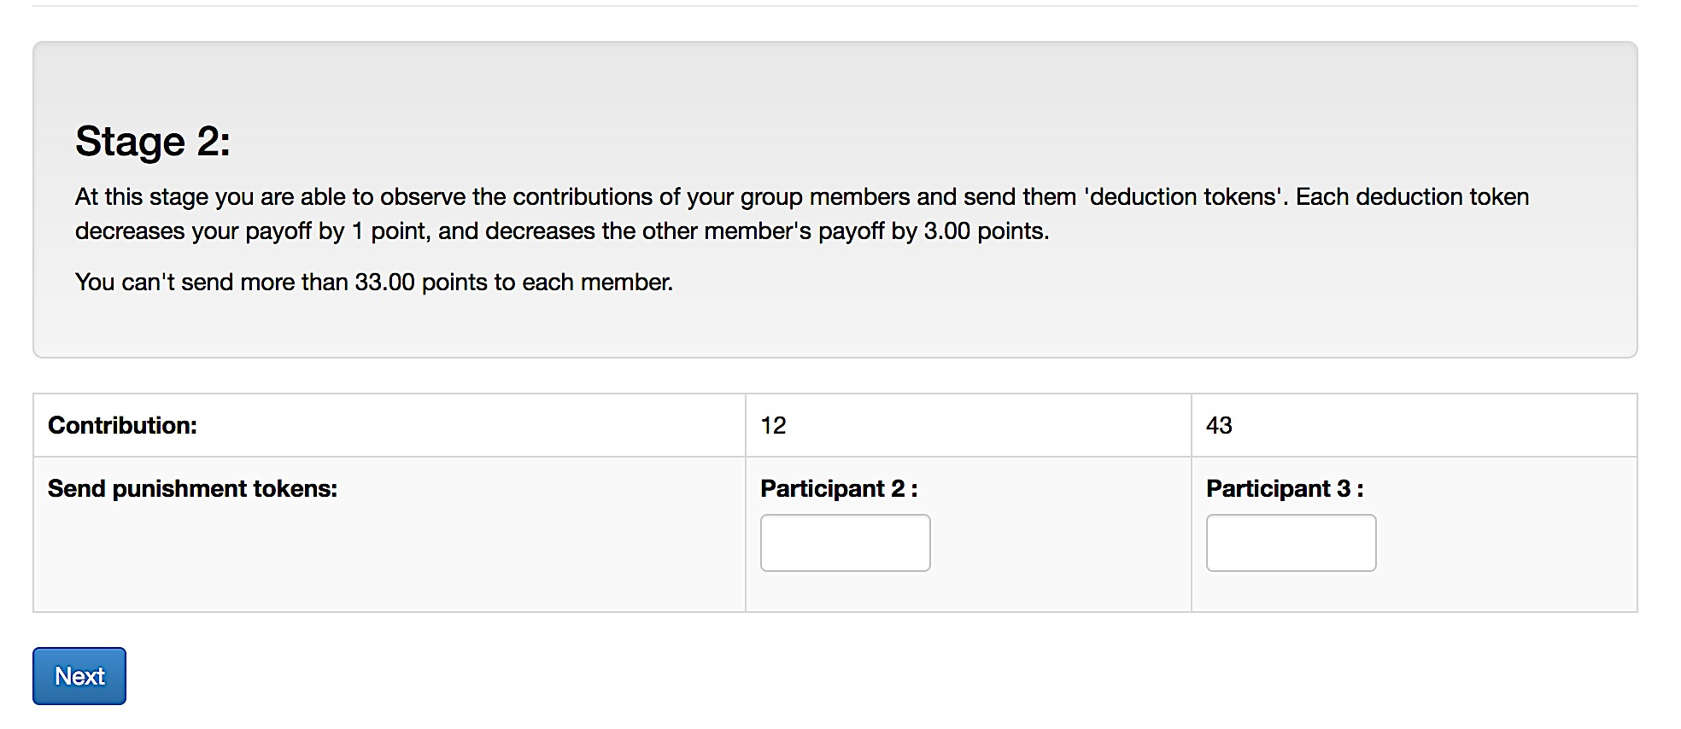
Public good game with punishment

Slide 32
Public good game with punishment
What’s the problem?
if there are 3 players, we need to create 3 fields.
Pass the fields conditionally so people can’t punish themselves
When we calculate the punishment we need first to sum up all P-fields for each player, and then each P-field across players….
…. And then our boss asks now to run the same game not for 3, but for 4 players…

Slide 33
Public good game with punishment
we need ‘punishment matrix’
Group | Sender_id_in_group | Receiver_id_in_group | Punishment_sent

Slide 34
Public good game with punishment
Group | Sender_id_in_group | Receiver_id_in_group | Punishment_sent
1 | 1 | 2 | 5
1 | 2 | 3 | 10
1 | 1 | 3 | 15
for each player in a group: punishment sent: sum of punishment_sent if group=self.group and sender_id=self.id_in_group

Slide 35
Public good game with punishment
Group | Sender_id_in_group | Receiver_id_in_group | Punishment_sent
1 | 1 | 2 | 5
1 | 2 | 3 | 10
1 | 1 | 3 | 15
for each player in a group: punishment received: sum of punishment_sent if group=self.group and receiver_id=self.id_in_group

Slide 36
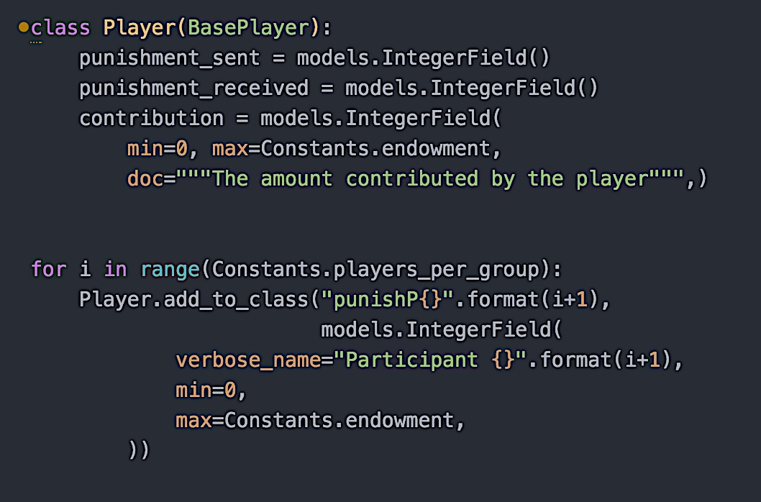
adding arbitrary number of fields to model

Slide 37
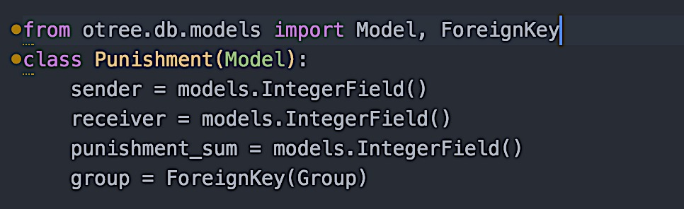
Creating a new model (aka table in zTree)

Slide 38
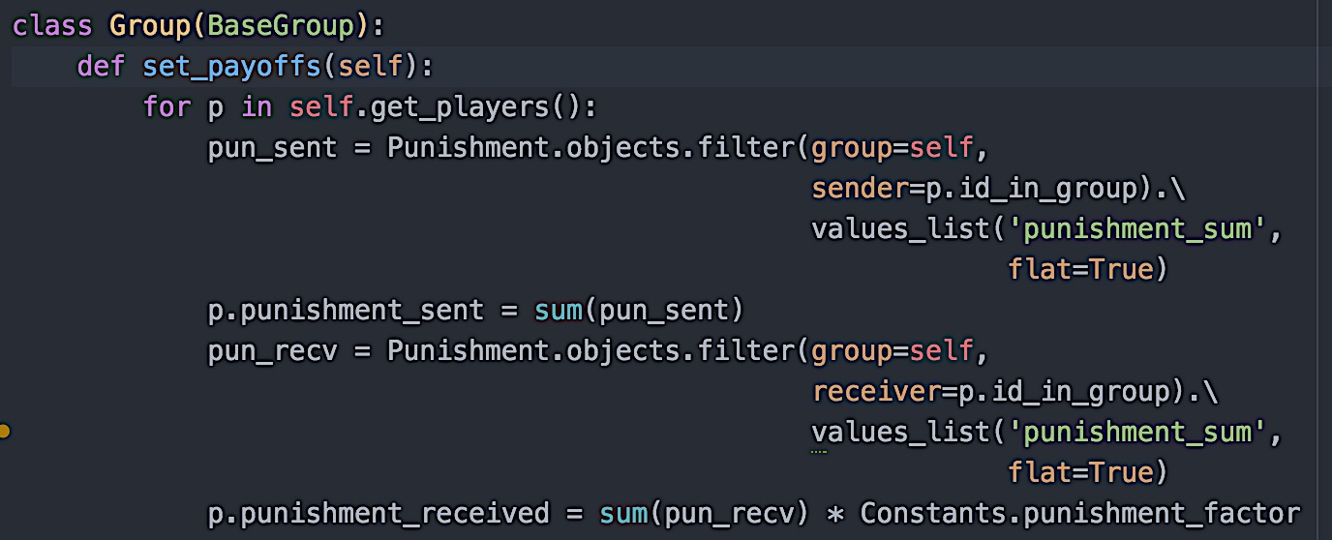
Calculating punishment sent and received

Slide 39
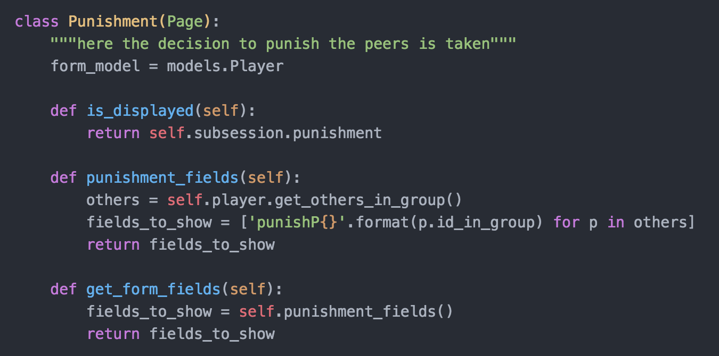
Passing only punishment fields of others

Slide 40
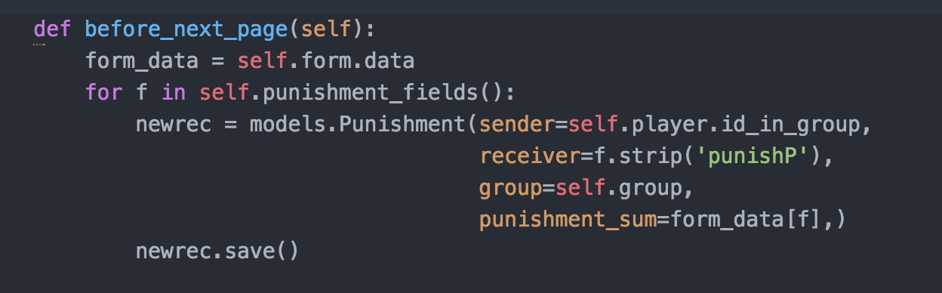
Saving punishment decisions in our new model (aka table)

Slide 41
Django channels
in settings.py:
CHANNEL_ROUTING = 'miniebay.routing.channel_routing’
in your app: 2 new files:
routing.py
consumers.py

Slide 42
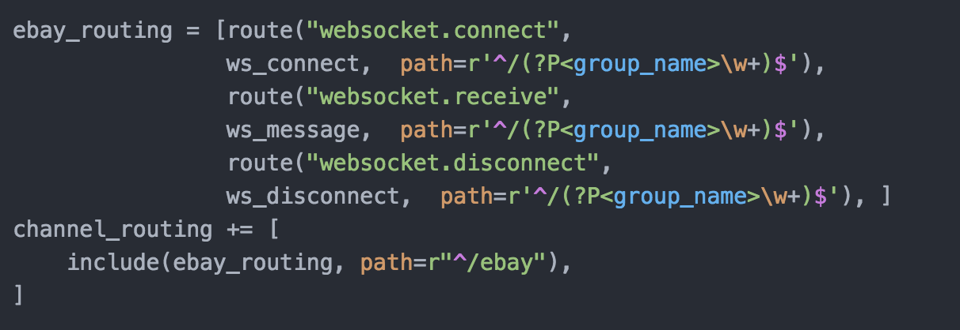
routing.py:

Slide 43
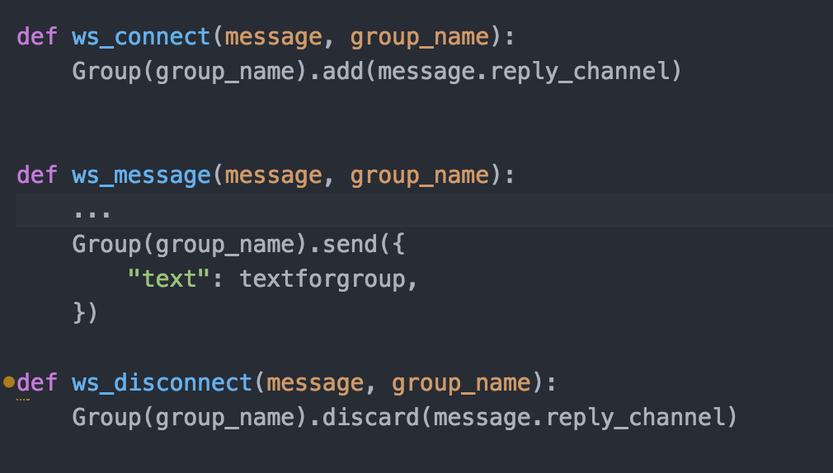
consumers.py:

Slide 44
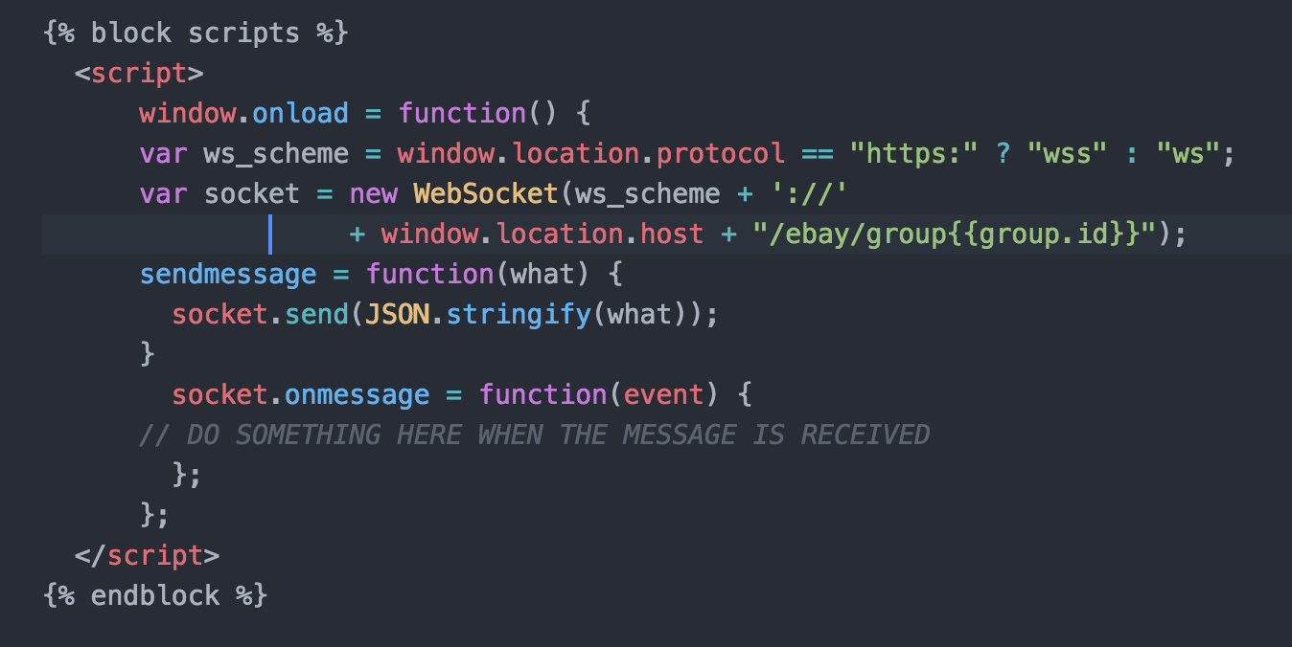
in template

